Slide 1


Hawaii

Slide 2
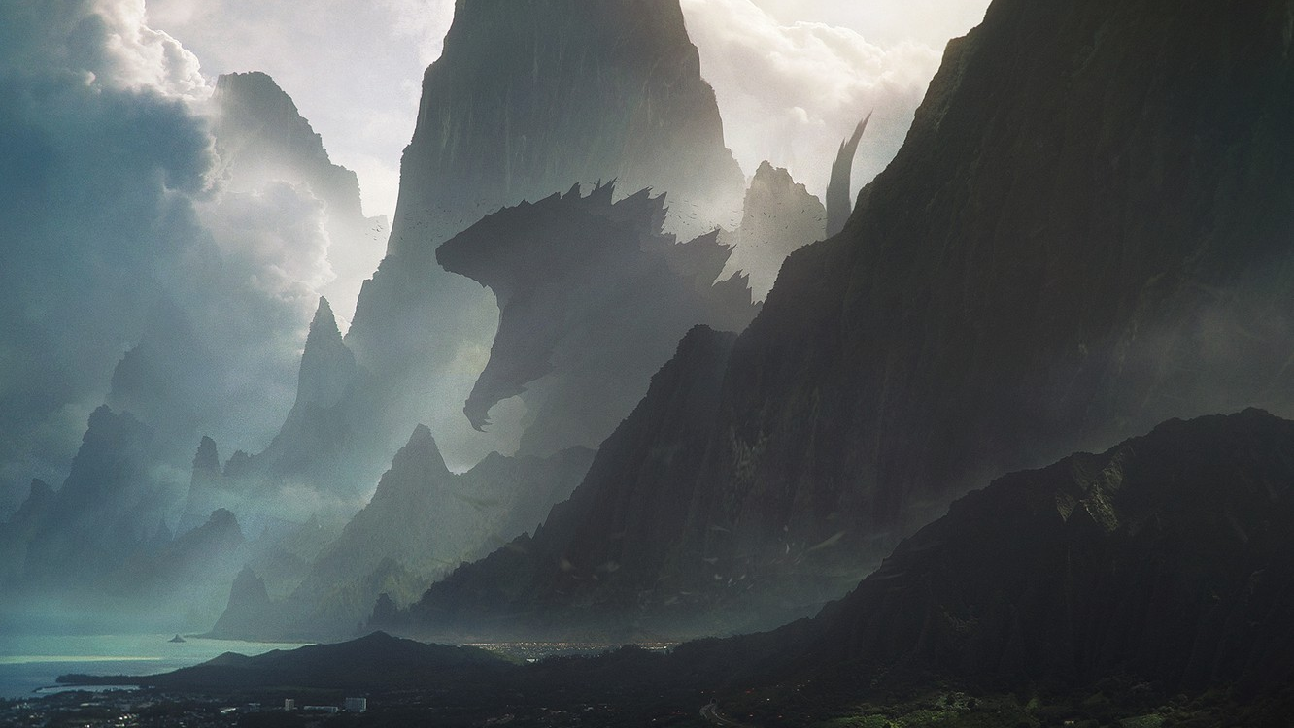

Slide 3
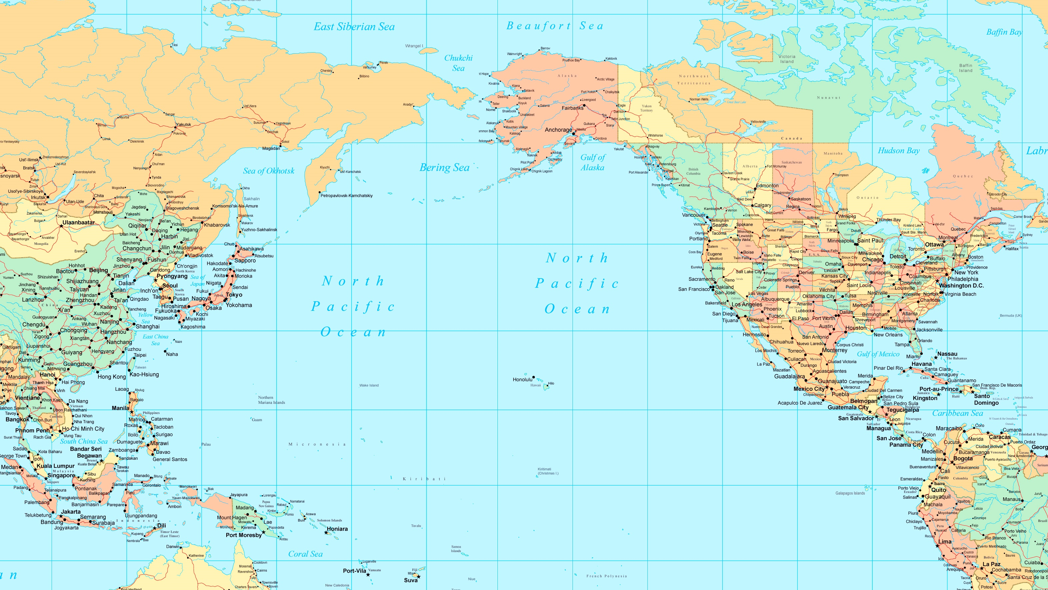
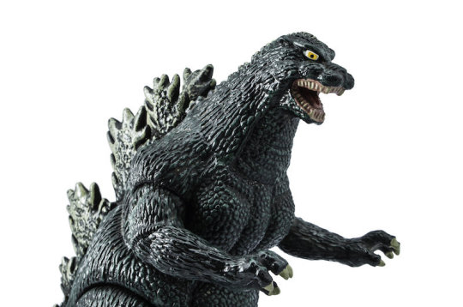

Slide 5
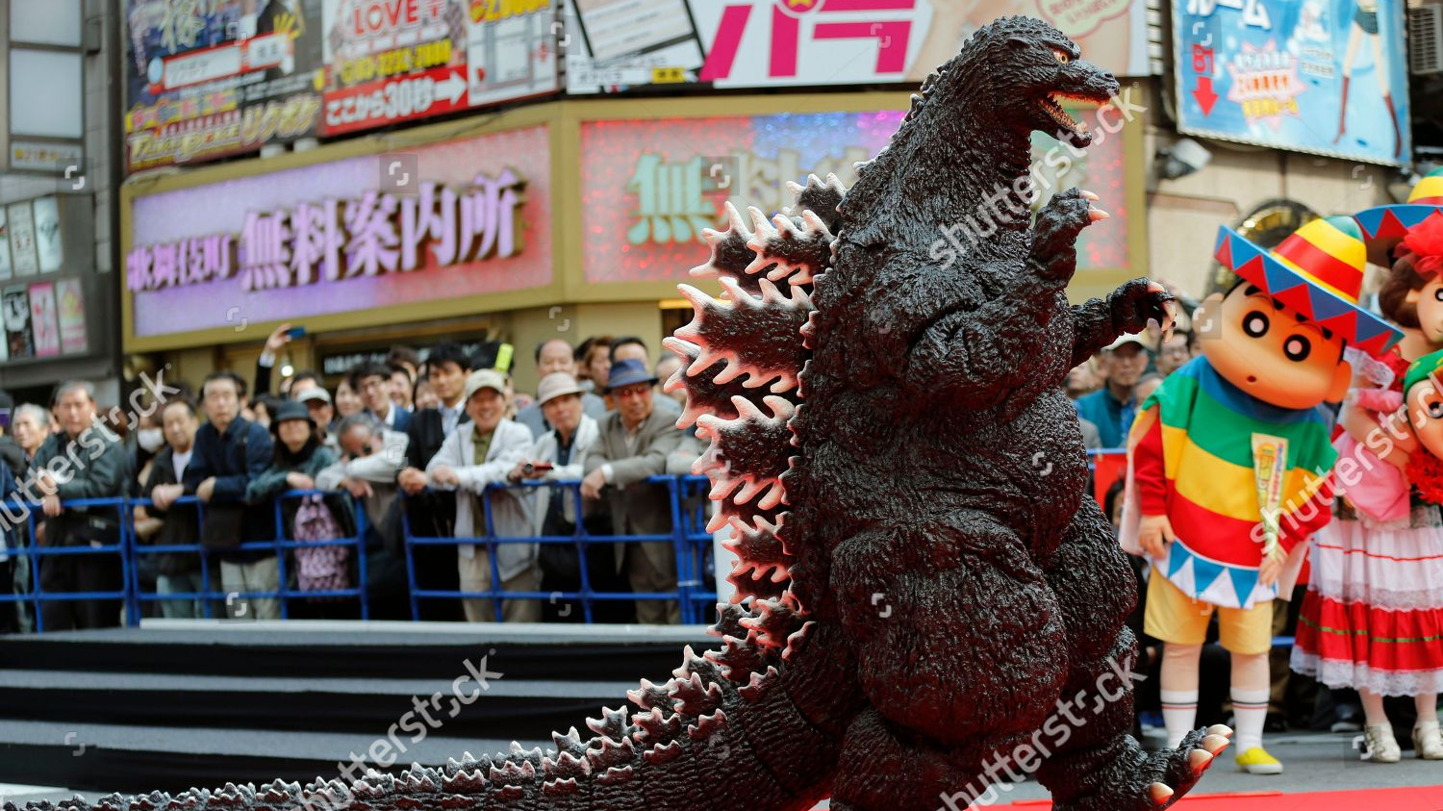

Slide 6
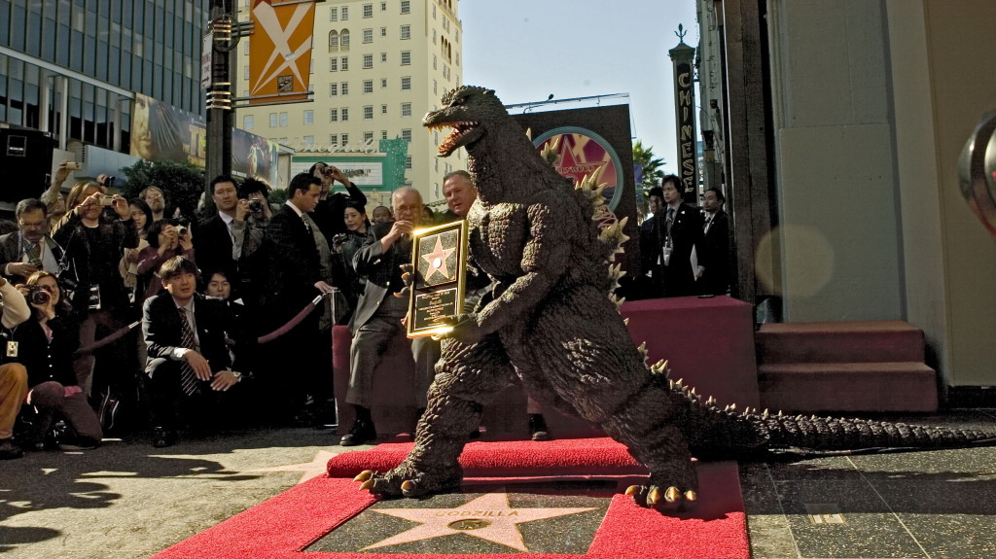

Slide 7
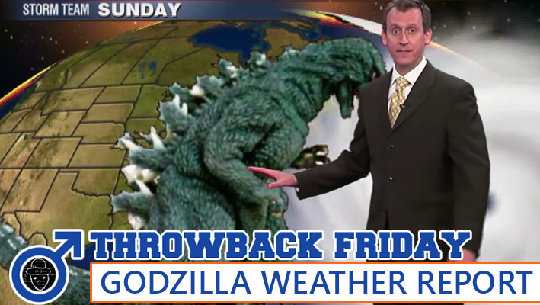

Slide 8

Data Assimilation for Agent-Based Models (DUST)
Benjamin Isaac Wilson – Prof. Nick Malleson – Jon Ward – Minh Le Kieu

Slide 9
Objectives
To understand the utility of modern probabilistic programming languages(PPLs).
Apply PPLs to model a simple singular agent (Godzilla).
Perform some inference on his behaviour.

Slide 10




Pyro probabilistic programming language.

Slide 11

Representing uncertainty in the real world.

Slide 12

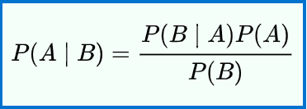
What is a probabilistic programming language?

Slide 13
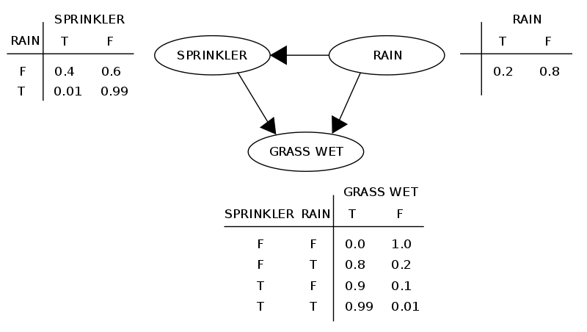

Slide 14
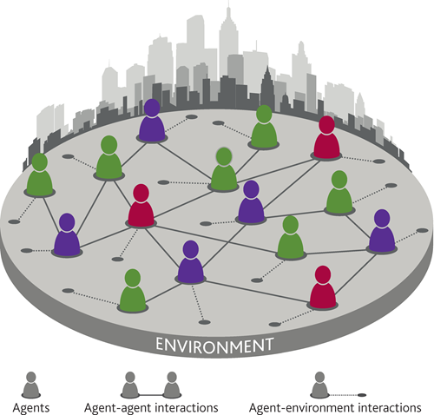
Can we apply these modern PPLs to Agent-Based Models to more accurately predict emergent behaviors?

Slide 15
Traditional ABM forecasts quickly diverge from reality.
Uncertainty

Slide 16
Start
Observe and Assimilate
Uncertainty reduced
Uncertainty

Slide 17
Primitives in Pyro
Stochastic functions or distributions are used to embed uncertainty and randomness into a model of something in the real world.
In this case, its our agent, Godzilla

Slide 18
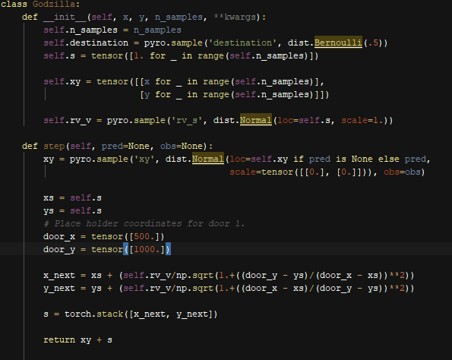

Slide 23
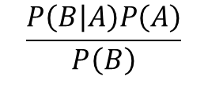
$$\frac{P\left(B | A\right)P\left(A\right)}{P\left(B\right)}$$
?

Slide 24

Data Assimilation
How can we update our belief and make a better prediction about Godzilla's function(where he is going)?

Slide 25
$$\frac{P\left(B | A\right)P\left(A\right)}{P\left(B\right)}$$
Observe or take a measurement!

Slide 26
$$\frac{P\left(B | A\right)P\left(A\right)}{P\left(B\right)}$$

Slide 27
$$\frac{P\left(B | A\right)P\left(A\right)}{P\left(B\right)}$$

Slide 28
$$\frac{P\left(B | A\right)P\left(A\right)}{P\left(B\right)}$$
If a unexpected measurement is taken then we can update our predictive model to represent this.

Slide 29
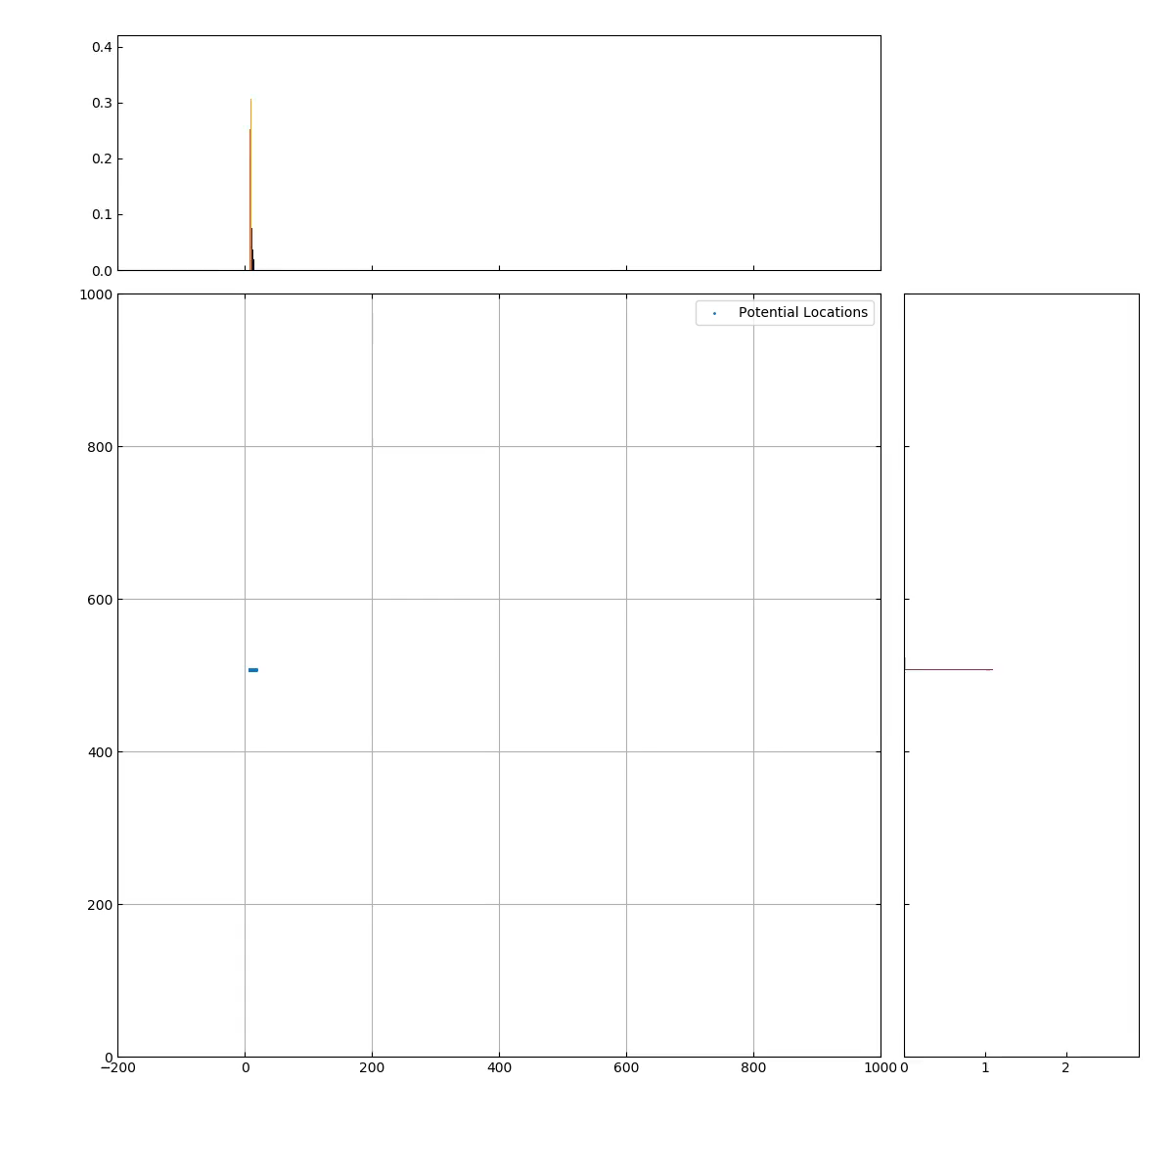
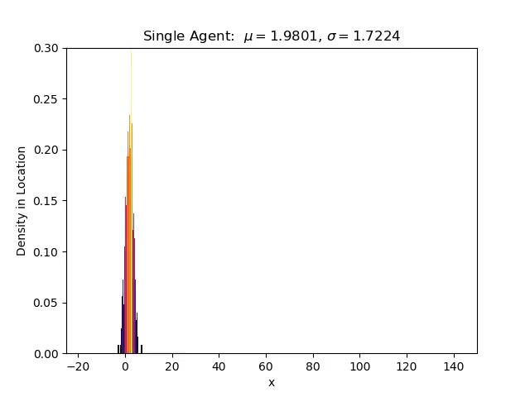
What does this look like in the current program?

Slide 30
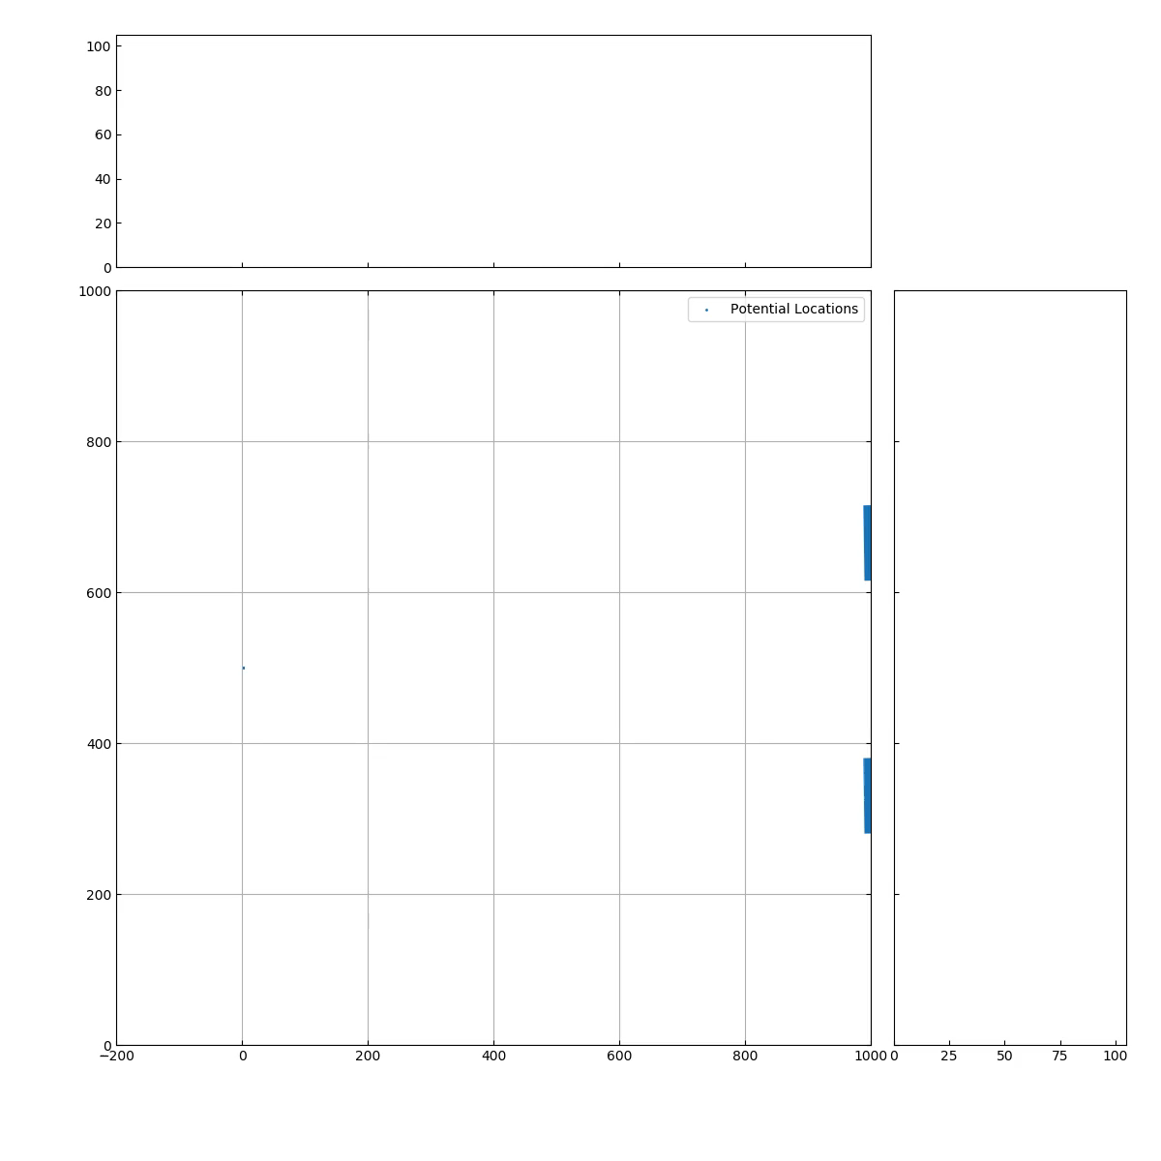

Slide 31
TODO:
Start inference.
Understand what it would take to scale up to a full ABM framework.
Make our environment complex.
Decide on programming paradigms
Pure Object-oriented programming or Data oriented programming?

